Slide 1
Heap
A Heap is a complete binary tree data structure that satisfies the heap property:
A Heap is a special Tree-based Data Structure that has the following properties.
It is a Complete Binary Tree.
It either follows max heap or min heap property.
Heaps are usually used to implement priority queues, where the smallest (or largest) element is always at the root of the tree.

Slide 2
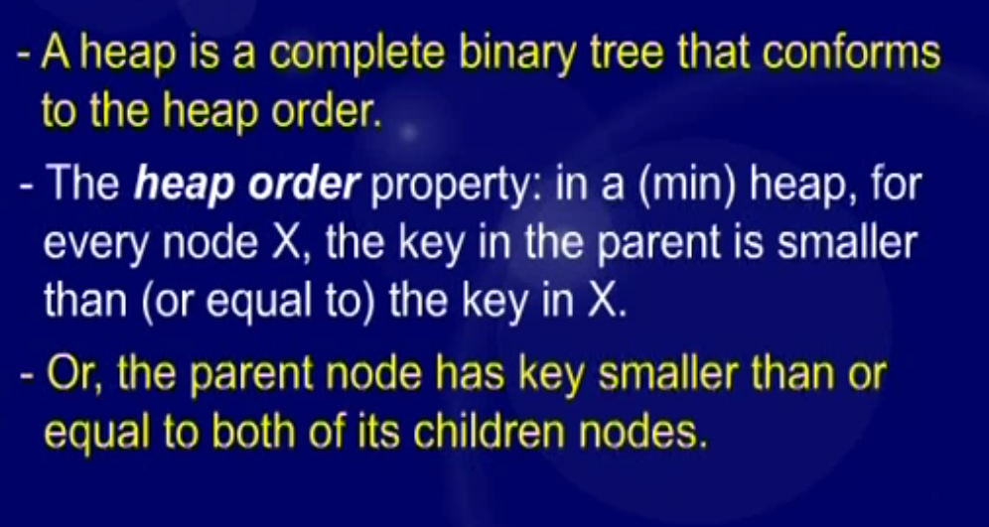
Min Heap

Slide 3
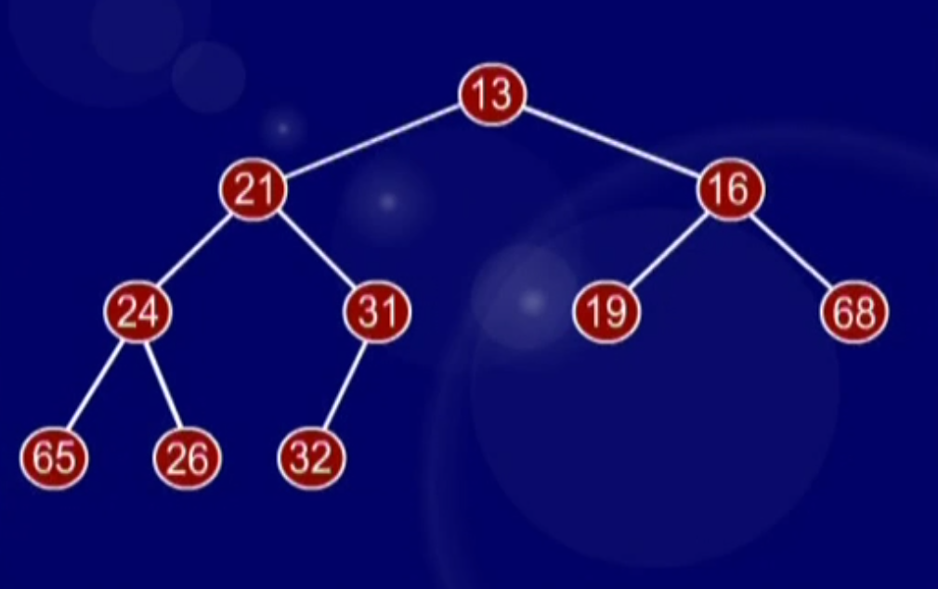
Min Heap

Slide 4
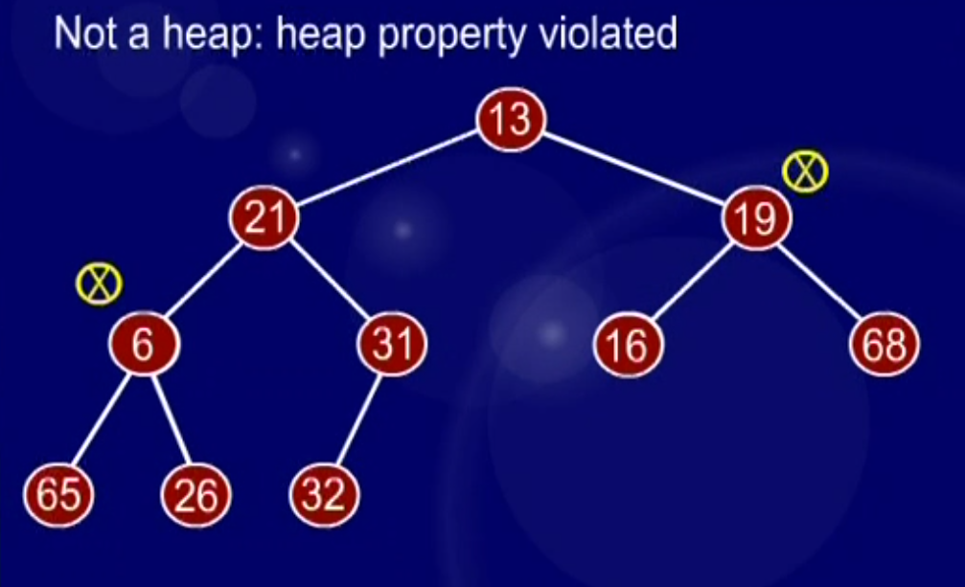
Min Heap

Slide 5
Max Heap
Max-Heap: The value of the root node must be the greatest or equal among all its descendant nodes and the same thing must be done for its left and right sub-tree also.
Min-Heap: The value of the root node must be the smallest or equal among all its descendant nodes and the same thing must be done for its left and right sub-tree also.

Slide 6
Properties of Heap:
The minimum or maximum element is always at the root of the heap, allowing constant-time access.
The relationship between a parent node at index ‘i’ and its children is given by the formulas: left child at index 2i+1 and right child at index 2i+2 for 0-based indexing of node numbers.
left child at index 2i and right child at index 2i+1 for 1-based indexing of node numbers.

Slide 7
Properties of Heap:
As the tree is complete binary, all levels are filled except possibly the last level. And the last level is filled from left to right.
When we insert an item, we insert it at the last available slot and then rearrange the nodes so that the heap property is maintained.
When we remove an item, we swap root with the last node to make sure either the max or min item is removed. Then we rearrange the remaining nodes to ensure heap property (max or min)

Slide 8
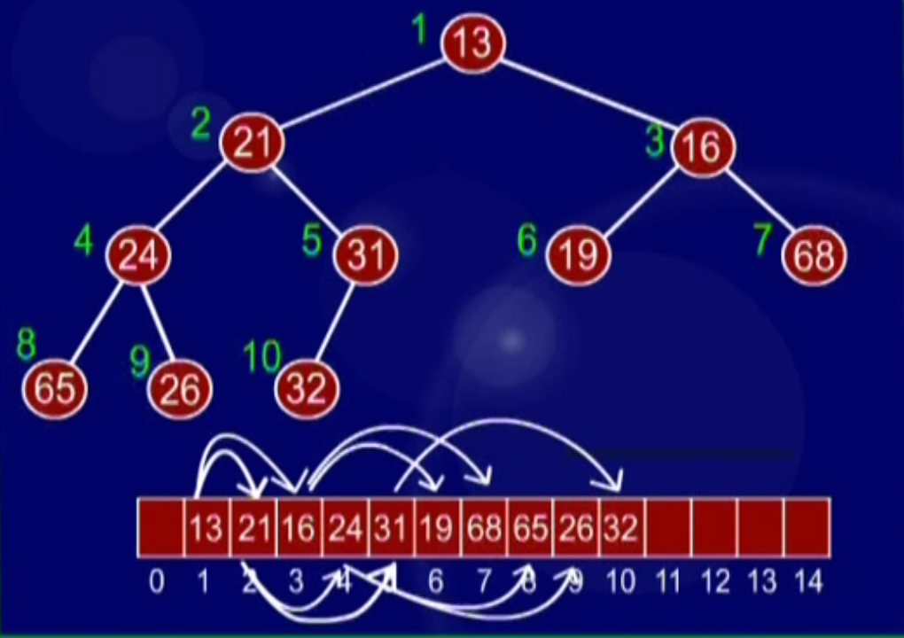
Example

Slide 9
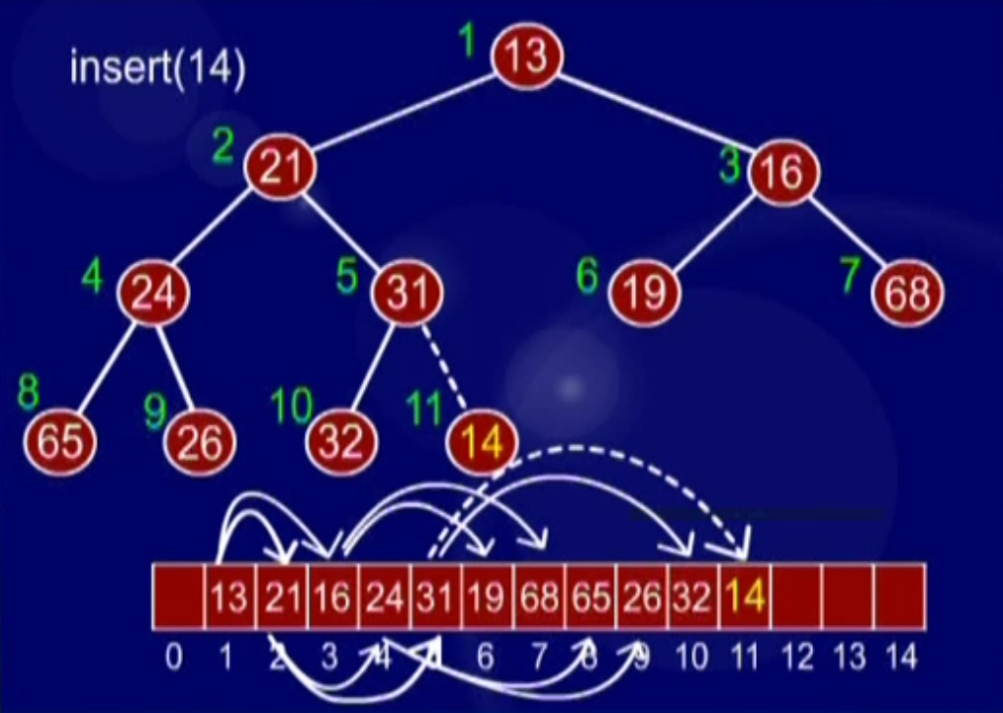
Insert

Slide 10
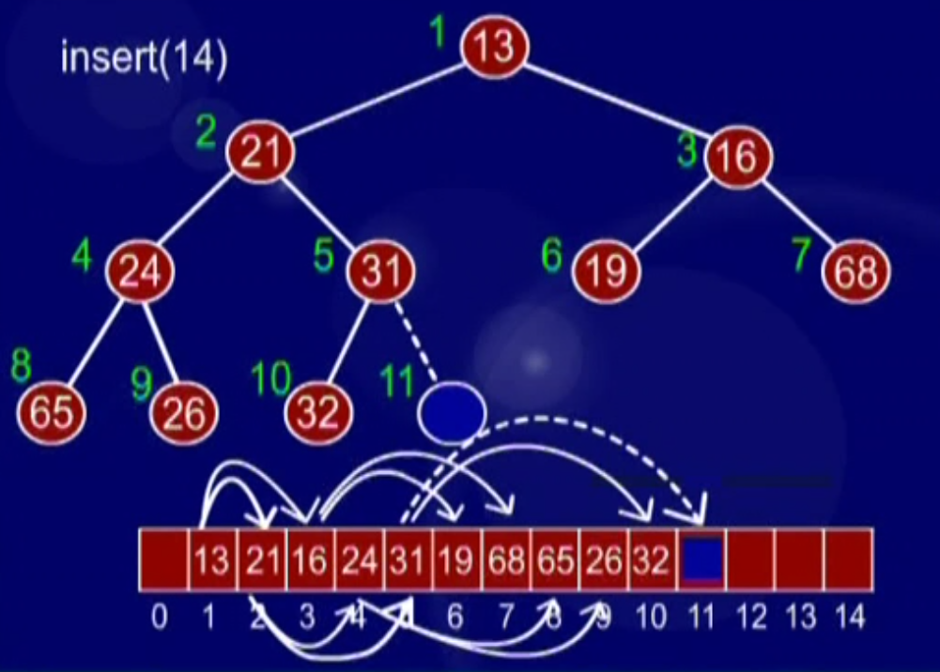
Insert

Slide 11
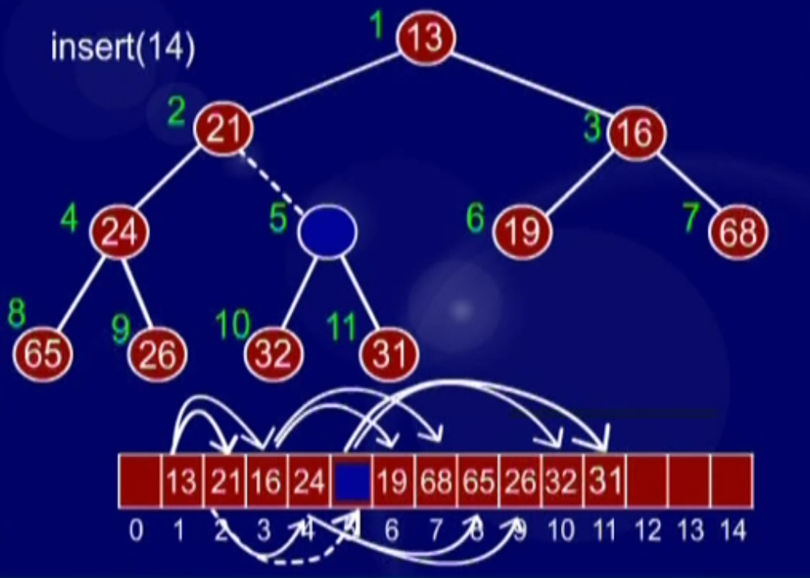
Insert

Slide 12
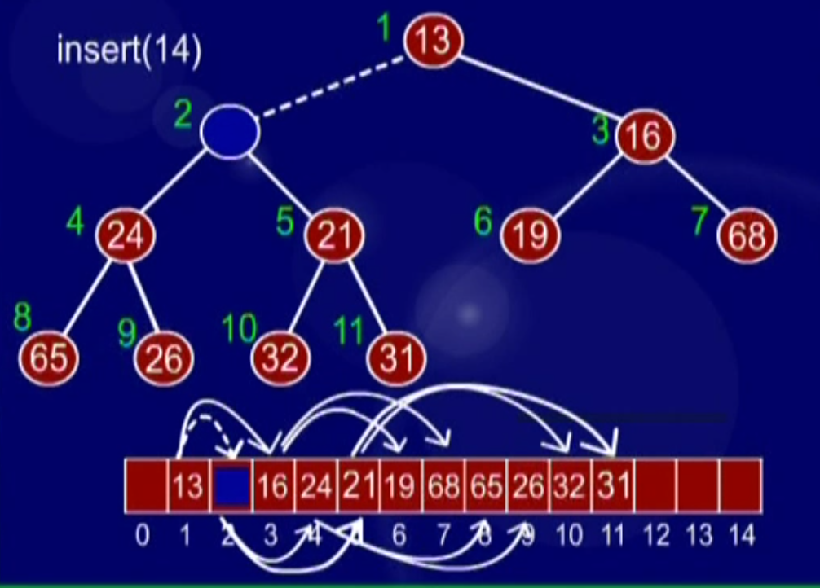
Insert

Slide 13
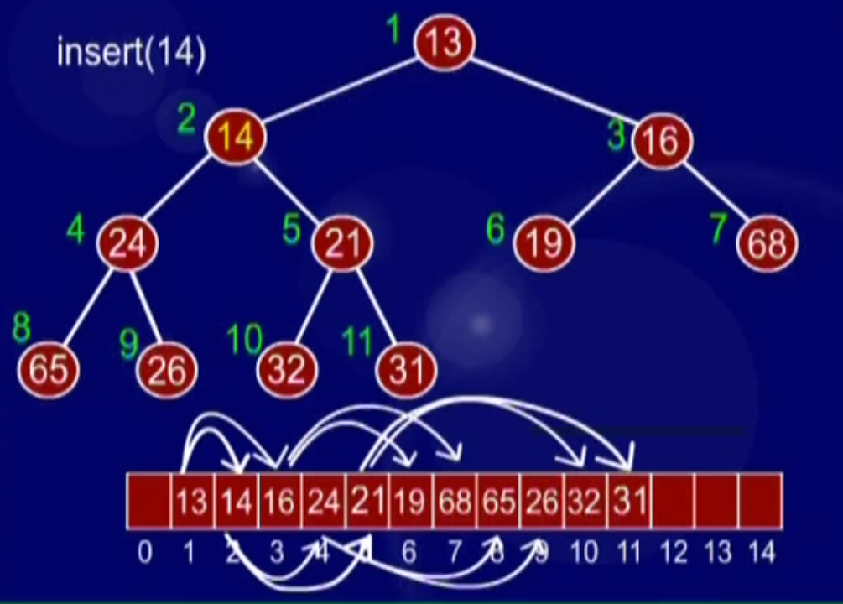
Insert
Notes:
End of lecture 41. Start of lecture 42.

Slide 14
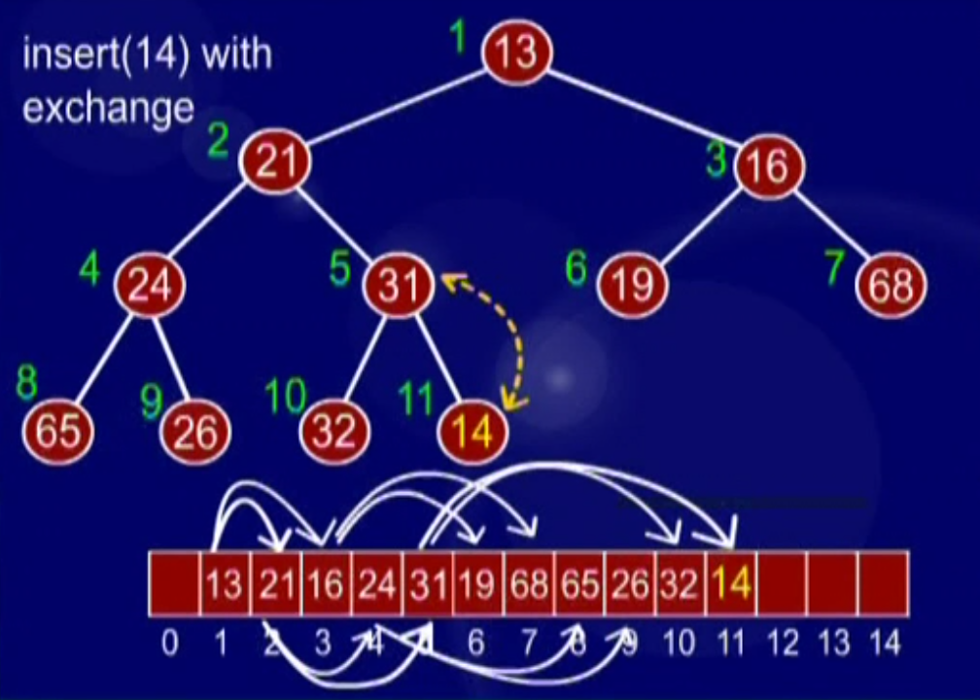
Insert

Slide 15
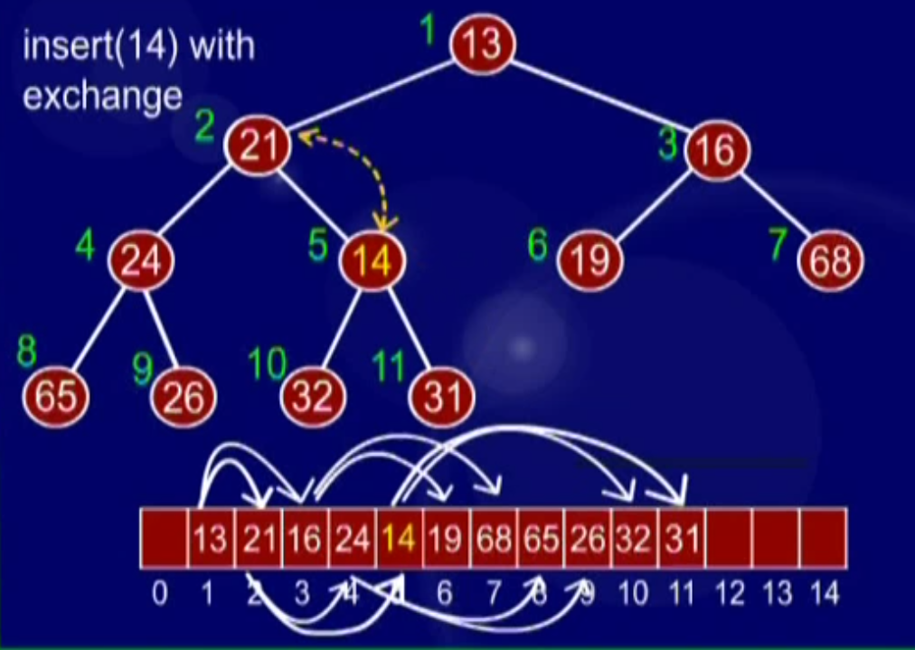
Insert

Slide 16
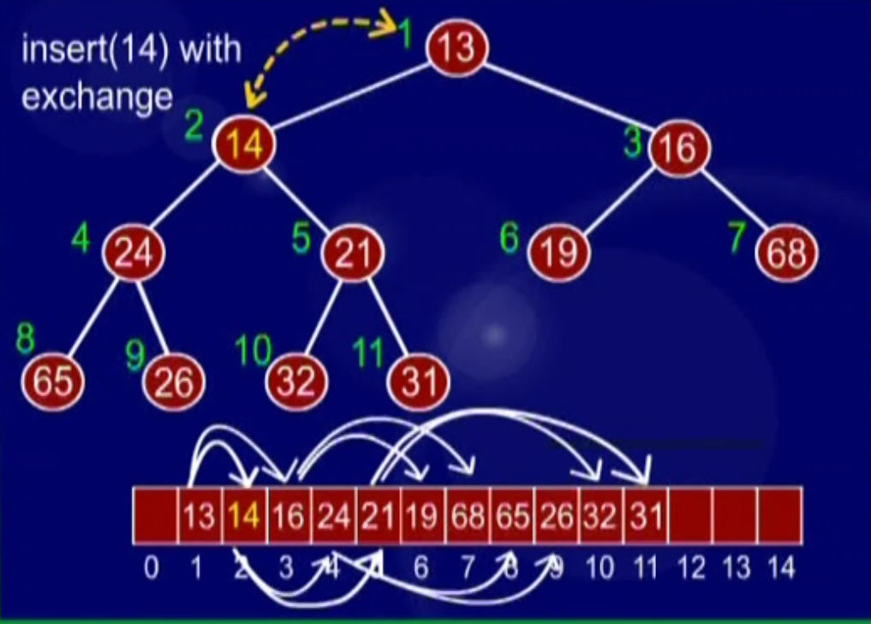
Insert

Slide 17
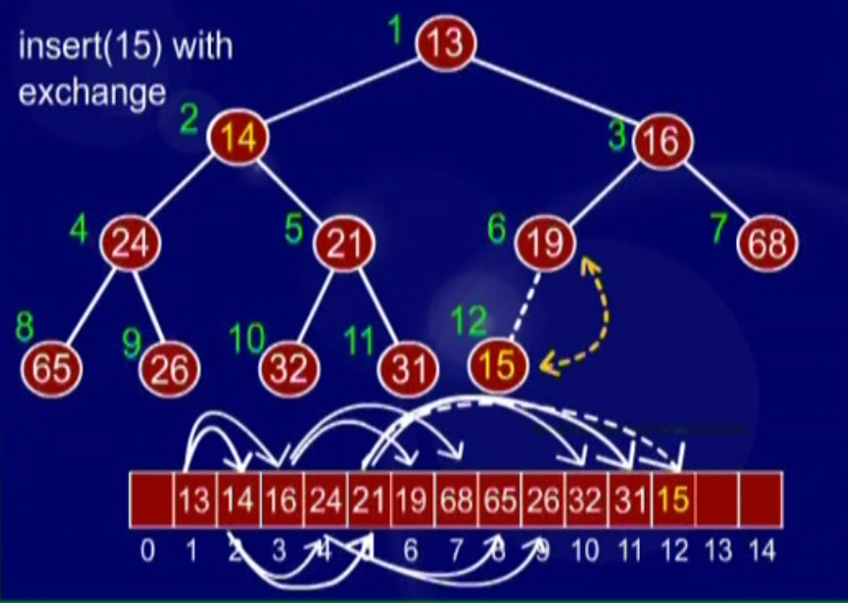
Insert

Slide 18

Insert

Slide 19
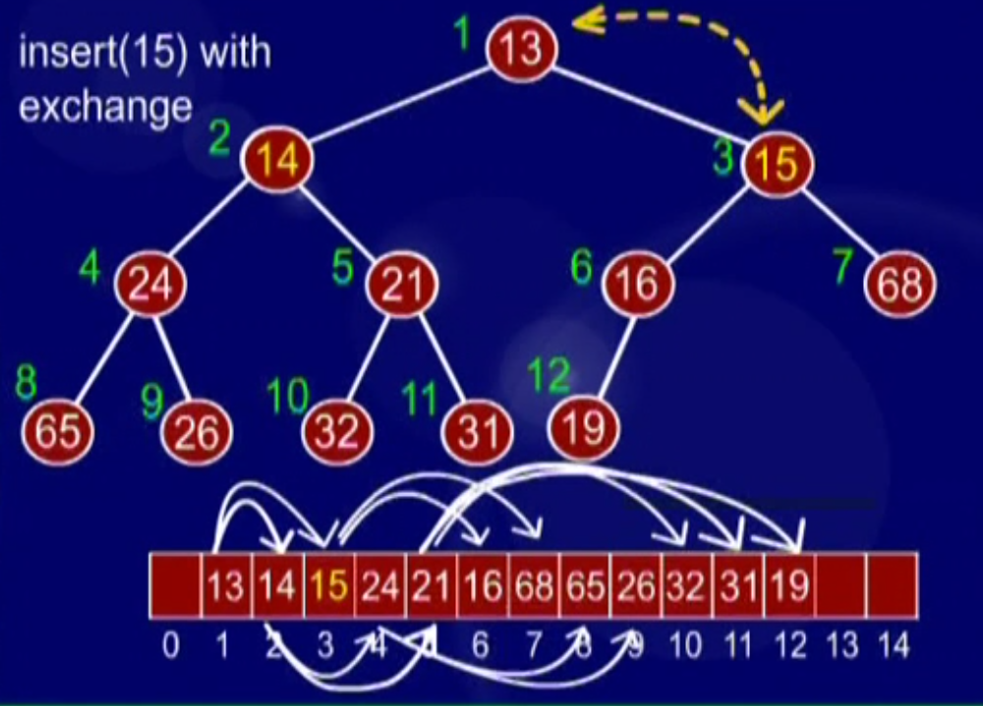
Insert
AL

Slide 20
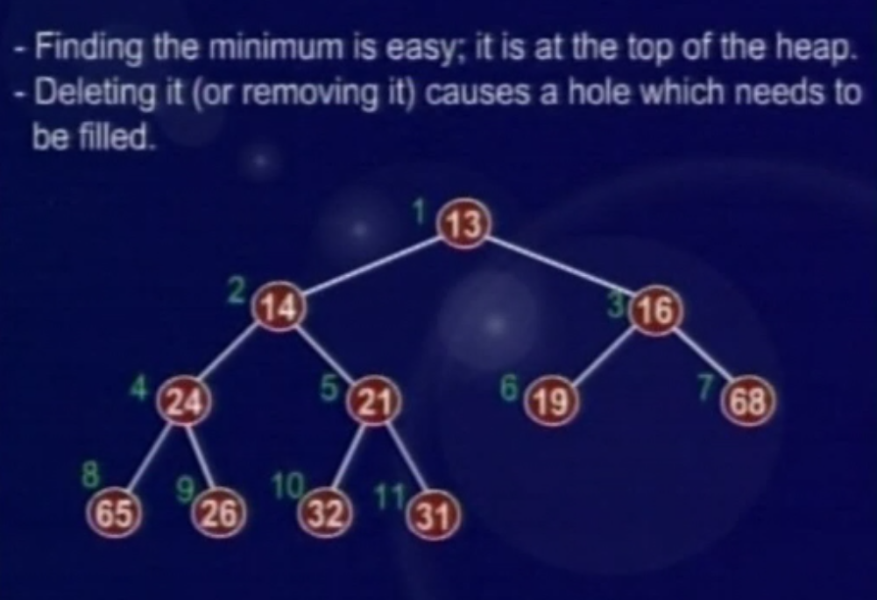
Delete Min

Slide 21
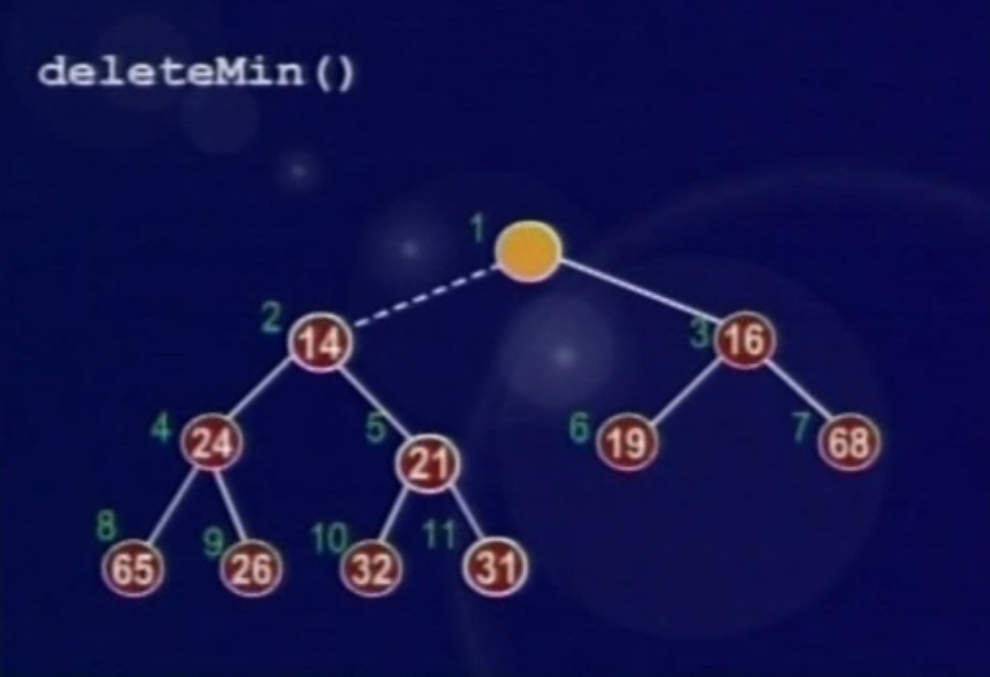
Delete Min

Slide 22
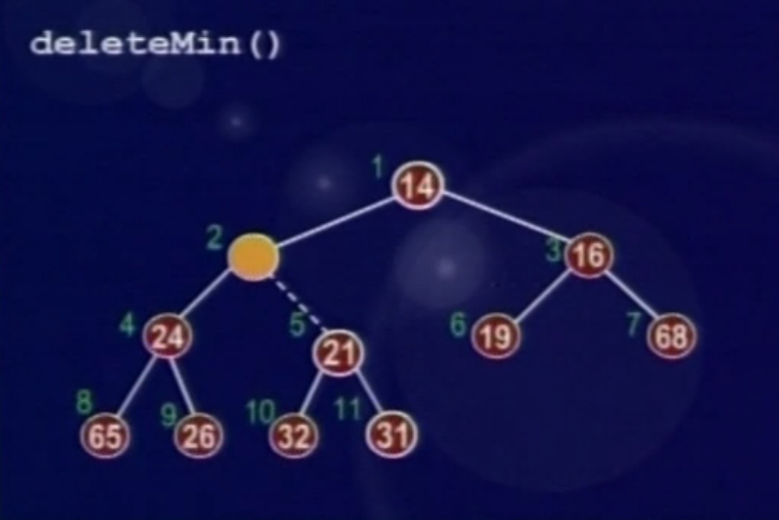
Delete Min

Slide 23
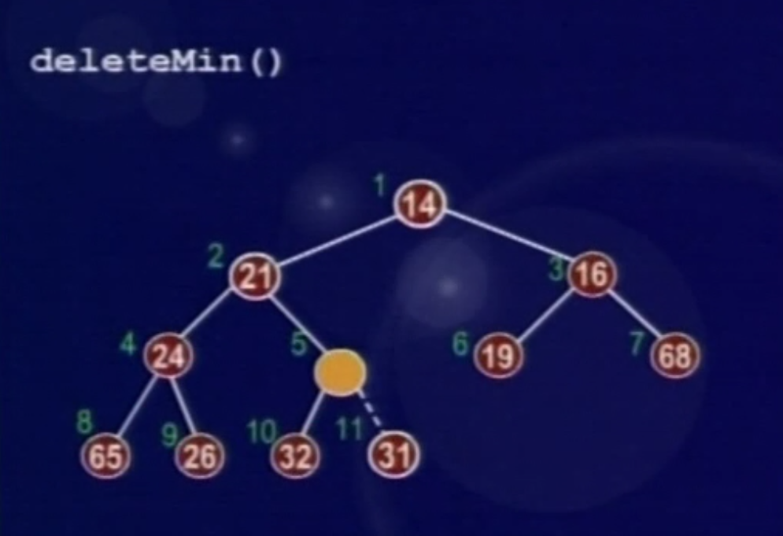
Delete Min

Slide 24
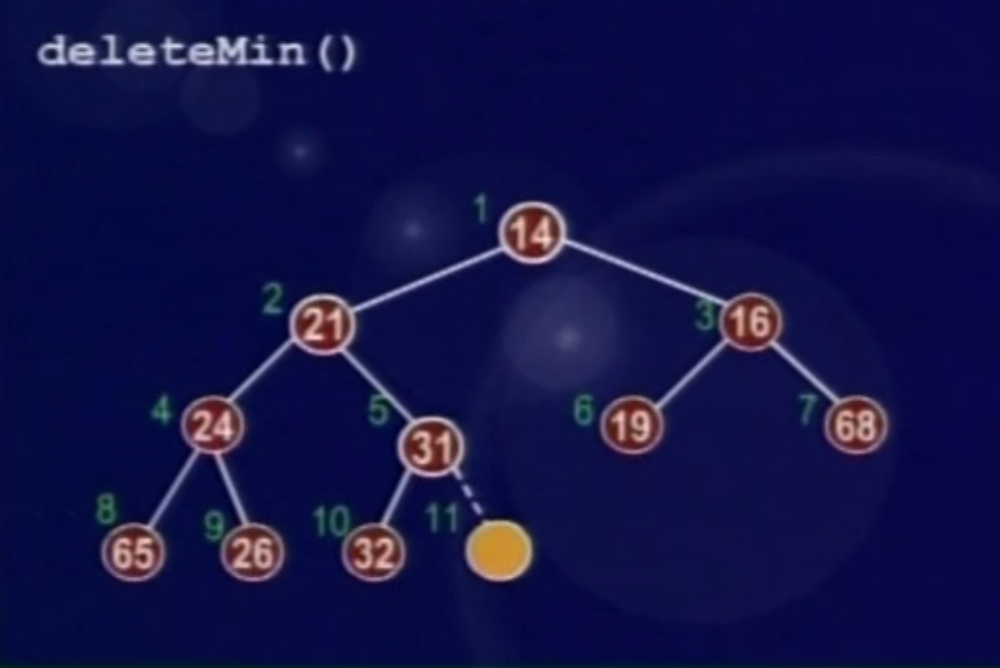
Delete Min

Slide 25
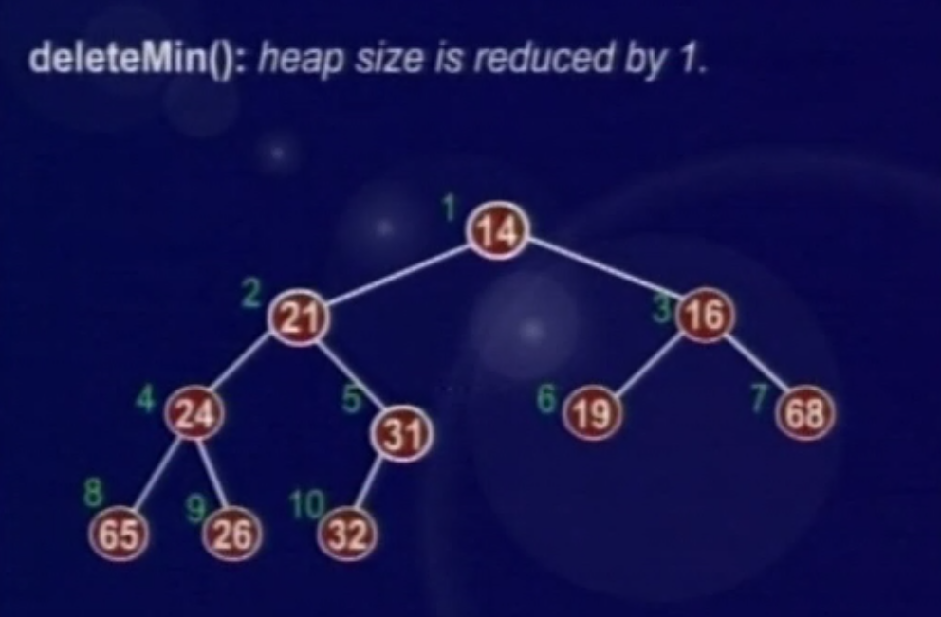
Delete Min

Slide 26
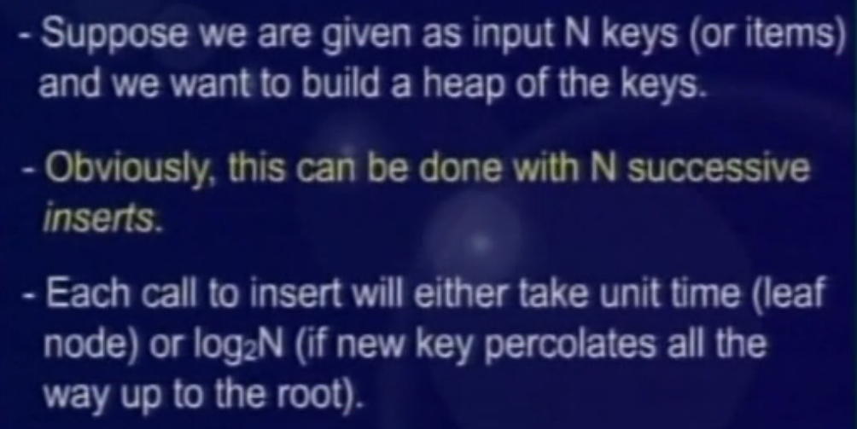
Build Heap

Slide 27
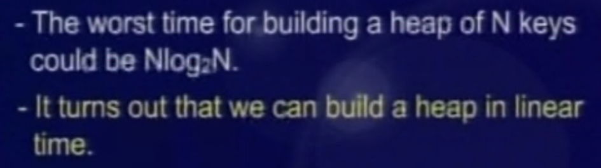
Build Heap

Slide 28
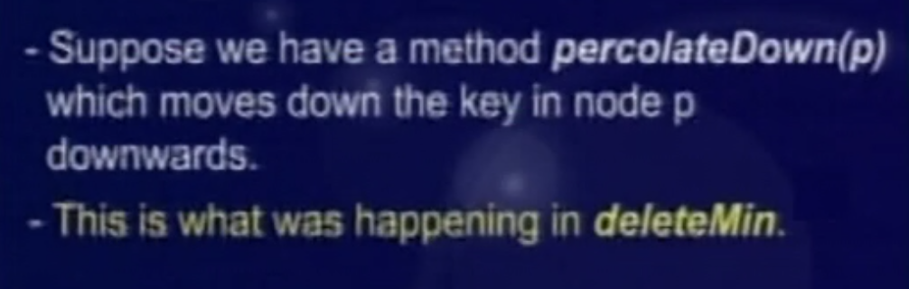
Build Heap

Slide 29
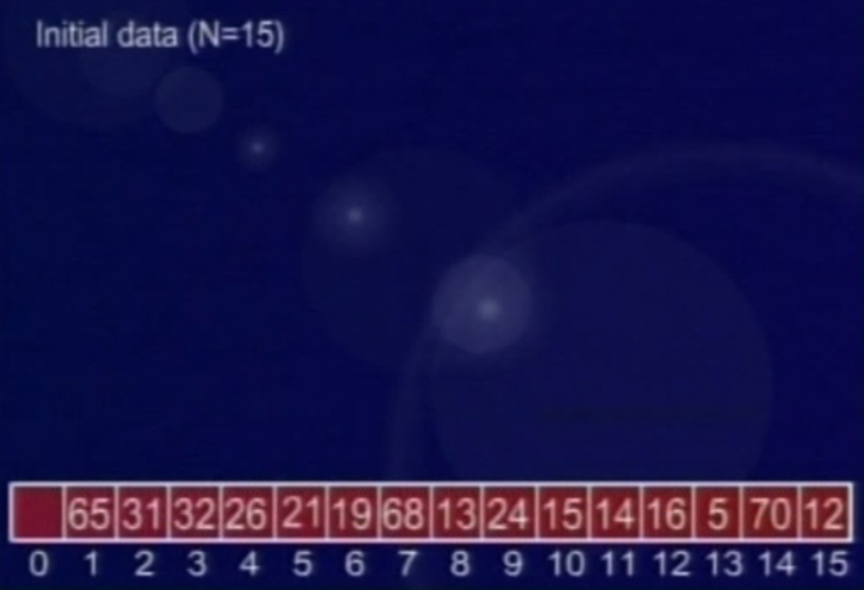
Build Heap
Notes:
End of Lecture 42.

Slide 30
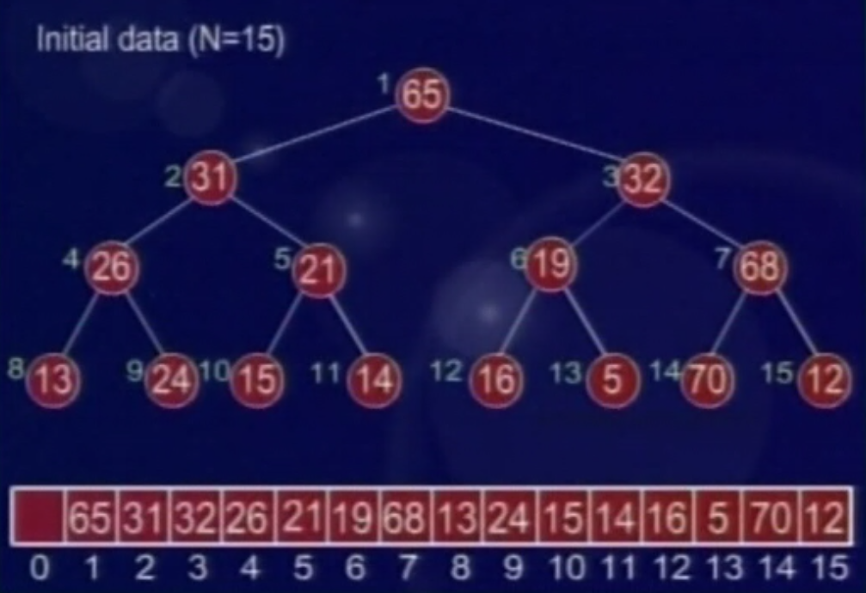
Build Heap
Notes:
Start of lecture 43 after animation.

Slide 31
BuildHeap
The general algorithm is to place the N keys in an array and consider it to be an unordered binary tree.
The following algorithm will build a heap out of N keys.
  for( i = N/2; i > 0; i-- )
  percolateDown(i);
Notes:
Star of lecture 31

Slide 32
BuildHeap
i = 15/2 = 7
1
65
Why I=n/2?
2
31
3
32
4
5
6
7
26
21
19
68
⬅ i
8
13
9
24
10
15
11
14
12
16
13
5
14
70
15
12
i
65
31
32
26
21
19
68
13
24
15
14
16
5
70
12
0
1
2
3
4
5
6
7
8
9
10
11
12
13
14
15

Slide 33
BuildHeap
i = 15/2 = 7
1
65
2
31
3
32
4
5
6
7
26
21
19
12
⬅ i
8
13
9
24
10
15
11
14
12
16
13
5
14
70
15
68
i
65
31
32
26
21
19
12
13
24
15
14
16
5
70
68
0
1
2
3
4
5
6
7
8
9
10
11
12
13
14
15

Slide 34
BuildHeap
i = 6
1
65
2
31
3
32
4
5
6
⬅ i
7
26
21
19
12
8
13
9
24
10
15
11
14
12
16
13
5
14
70
15
68
i
65
31
32
26
21
19
12
13
24
15
14
16
5
70
68
0
1
2
3
4
5
6
7
8
9
10
11
12
13
14
15

Slide 35
BuildHeap
i = 5
1
65
2
31
3
32
4
5
6
7
26
21
⬅ i
5
12
8
13
9
24
10
15
11
14
12
16
13
19
14
70
15
68
i
65
31
32
26
21
5
12
13
24
15
14
16
19
70
68
0
1
2
3
4
5
6
7
8
9
10
11
12
13
14
15
Notes:
End of lecture 30

Slide 36
BuildHeap
i = 4
1
65
2
31
3
32
4
5
6
7
26
⬅ i
14
5
12
8
13
9
24
10
15
11
21
12
16
13
19
14
70
15
68
i
65
31
32
26
14
5
12
13
24
15
21
16
19
70
68
0
1
2
3
4
5
6
7
8
9
10
11
12
13
14
15

Slide 37
BuildHeap
i = 3
1
65
2
31
3
⬅ i
32
4
5
6
7
13
14
5
12
8
26
9
24
10
15
11
21
12
16
13
19
14
70
15
68
i
65
31
32
13
14
5
12
26
24
15
21
16
19
70
68
0
1
2
3
4
5
6
7
8
9
10
11
12
13
14
15

Slide 38
BuildHeap
i = 2
1
65
2
31
⬅ i
3
5
4
5
6
7
13
14
16
12
8
26
9
24
10
15
11
21
12
32
13
19
14
70
15
68
i
65
31
5
13
14
16
12
26
24
15
21
32
19
70
68
0
1
2
3
4
5
6
7
8
9
10
11
12
13
14
15

Slide 39
BuildHeap
i = 1
1
65
⬅ i
2
13
3
5
4
5
6
7
24
14
16
12
8
26
9
31
10
15
11
21
12
32
13
19
14
70
15
68
i
65
13
5
24
14
16
12
26
31
15
21
32
19
70
68
0
1
2
3
4
5
6
7
8
9
10
11
12
13
14
15

Slide 40
BuildHeap
Min heap
1
5
2
13
3
12
4
5
6
7
24
14
16
65
8
26
9
31
10
15
11
21
12
32
13
19
14
70
15
68
5
13
12
24
14
16
65
26
31
15
21
32
19
70
68
0
1
2
3
4
5
6
7
8
9
10
11
12
13
14
15

Slide 41
Other Heap Operations
decreaseKey(p, delta):
  lowers the value of the key at position ‘p’ by the amount ‘delta’. Since this might violate the heap order, the heap must be reorganized with percolate up (in min heap) or down (in max heap).
increaseKey(p, delta):
  opposite of decreaseKey.
remove(p):
  removes the node at position p from the heap. This is done by first decreaseKey(p, ) and then performing deleteMin().

Slide 42
Heap code in C++
template <class eType>
class Heap
{
public:
Heap( int capacity = 100 );
void insert( const eType & x );
void deleteMin( eType & minItem );
const eType & getMin( );
bool isEmpty( );
bool isFull( );
int Heap<eType>::getSize( );

Slide 43
Heap code in C++
private:
int currentSize; // Number of elements in heap
eType* array; // The heap array
int capacity;
void percolateDown( int hole );
};

Slide 44
Heap code in C++
#include "Heap.h“
template <class eType>
Heap<eType>::Heap( int capacity )
{
array = new etype[capacity + 1];
currentSize=0;
}

Slide 45
Heap code in C++
// Insert item x into the heap, maintaining heap
// order. Duplicates are allowed.
template <class eType>
bool Heap<eType>::insert( const eType & x )
{
if( isFull( ) ) {
cout << "insert - Heap is full." << endl;
return 0;
}
// Percolate up
int hole = ++currentSize;
for(; hole > 1 && x < array[hole/2 ]; hole /= 2)
array[ hole ] = array[ hole / 2 ];
array[hole] = x;
}

Slide 46
Heap code in C++
template <class eType>
void Heap<eType>::deleteMin( eType & minItem )
{
if( isEmpty( ) ) {
cout << "heap is empty.“ << endl;
return;
}
minItem = array[ 1 ];
array[ 1 ] = array[ currentSize-- ];
percolateDown( 1 );
}
Notes:
End of lecture 31, start of 32

